Slide 1

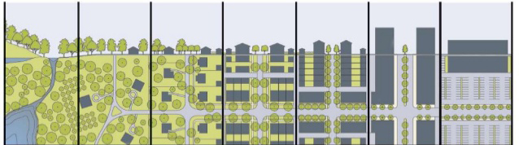
Defining the Level of Variability Within an Urban Classification System
Notes:
Intro to LCZ concept and Oke paper.

Slide 2
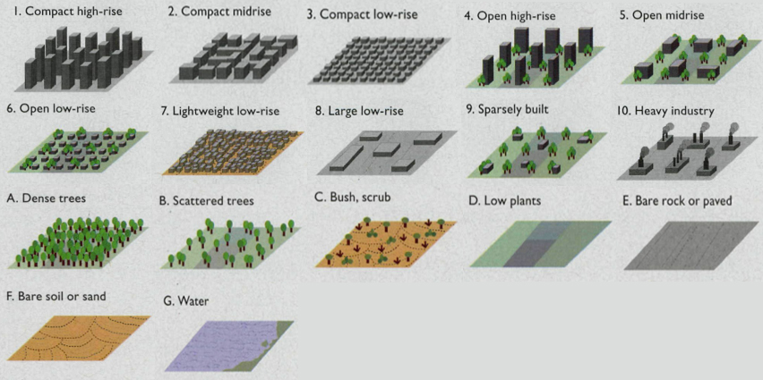
Notes:
Explain Local Climate Zones.

Slide 3
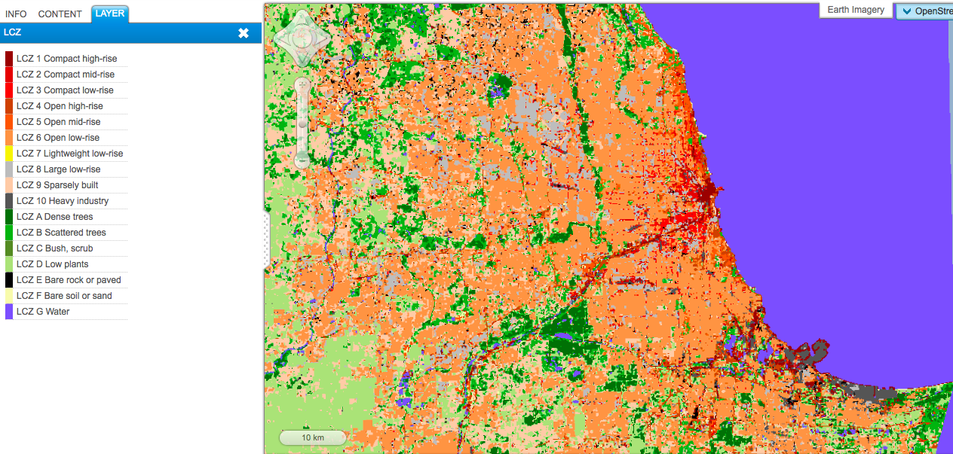
Notes:
Explain completed classification.

Slide 4
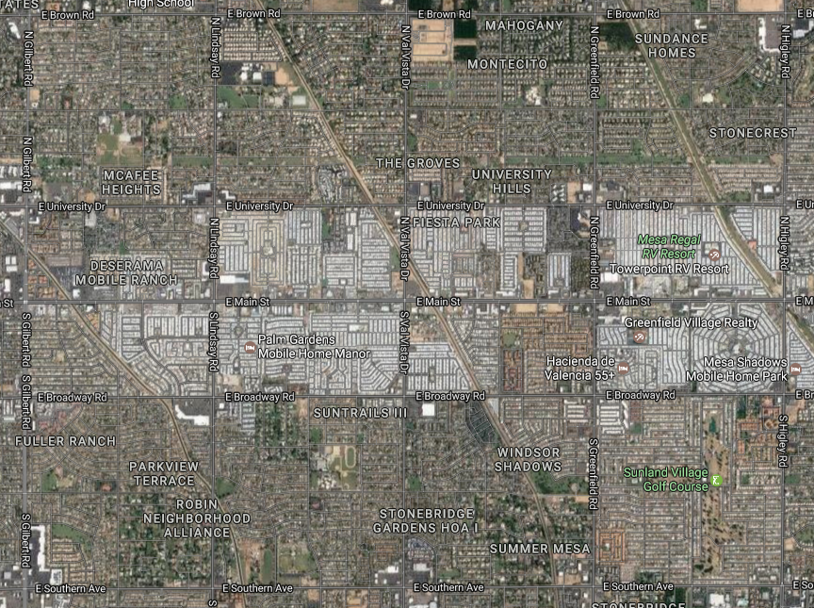
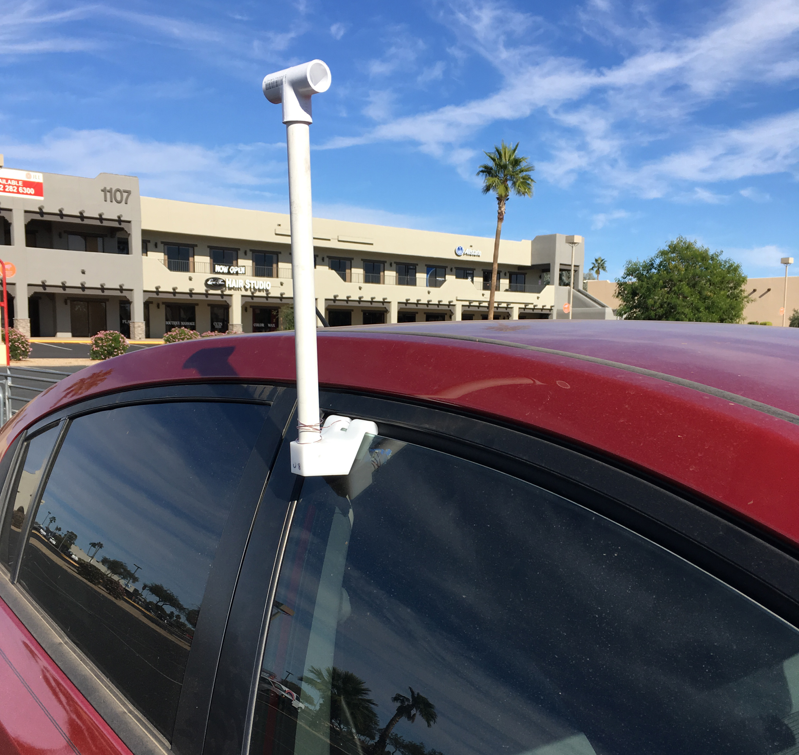
Notes:
Introduce project, lightweight low-rise vs. open low-rise

Slide 5
Notes:
Introduce raw data, discuss need to adjust for diurnal cooling.

Slide 6
Notes:
Briefly discuss GIS methods and discuss results.

Slide 7


Acknowledgements
Dr. Erin Saffell, my wonderful mentor, assisted with the design of the project and analysis.
Dr. Ryan Frazier assisted with GIS functions.
Dr. David Sailor allowed the use of meteorological instrumentation.
Funding provided by NASA Space Grant.

